Slide 1

Managing Microsoft Azure Stack Hub
Patching the Microsoft Azure Stack Hub Infrastructure
This work is licensed under a Creative Commons Attribution - ShareAlike 4.0 International Public License

Slide 2
Agenda
Overview
Servicing Policy
Update Packages
Update Flow
Administrative Tasks
Troubleshooting

Slide 3
Overview

Slide 4
Problem space
How can I avoid disruptions to my business/SLAs?
What updates do I install and what is the right order?
What tool(s) should I use?
Who do I call if there is an issue?
How often will updates be released?
What about security updates?
How do I know when updates are available and what has been tested or validated?
What about updates for my firmware and or drivers?
How can I generate compliance reports?
How do I know updates were actually applied to the correct endpoints?
How long should my maintenance windows be set?

Slide 5
Microsoft’s patch and update philosophy
Provide the ability to update the infrastructure while ensuring business applications, services, and workloads remain highly available (minimally disruptive)
Allow providers to focus on other aspects of the business
Provide an easy, safe, single-sourced update function released on a predictable cadence
Updates can and will range in scope from software to hardware – across all core components of the system
Provide predictability to better align with existing maintenance processes
Software updates are not applied to individual fabric VMs – a whole new (already patched) VM is swapped in, using clustering to maintain availability during the process

Slide 6
Servicing Policy

Slide 7
Servicing Policy
To receive support for your system, you must keep your Azure Stack Hub updated within a specific interval. The Azure Stack Hub Servicing policy allows a deferral of Microsoft software updates for up to three releases.
If your system is more than three releases behind, you’re considered out of compliance. You must update the system to at least the minimum supported version to receive support.
1805
1807
1808
1809
out-of-support
min supp. Version
latest release

Slide 8
Servicing Policy
The following table shows example update package releases, their prerequisite, and the minimum supported version that your system must be at to maintain support.
Microsoft software update packages are non-cumulative and require the previous update package as a prerequisite. If you decide to defer one or more updates, consider the overall runtime if you want to get to the latest version.
Latest Update Package (example) | Prerequisite | Minimum Supported Version
1710 | 1709 | N/A
1711 | 1710 | 1709
1712 | 1711 | 1710
1802 | 1712 | 1711
1803 | 1802 | 1712
1804 | 1803 | 1802

Slide 9

Update Packages

Slide 10
Package types
Azure Stack Hub knows two streams of update packages for integrated systems. Microsoft software updates, and updates that are specific to your hardware vendor, such as drivers and firmware.
Microsoft Updates are deployed through Azure Stack Hub. OEM hardware vendor provided updates and firmware updates are deployed through the Hardware Lifecycle Host (HLH) or a vendor specific Solution.
Source
Azure Stack Hub servicing policy https://docs.microsoft.com/en-us/azure/azure-stack/azure-stack-servicing-policy#update-package-types

Slide 11
Package types
Microsoft software updates
Microsoft is responsible for the end-to-end servicing lifecycle for the Microsoft software update packages.
These packages can include the latest Windows Server security updates, non-security updates, and Azure Stack Hub feature updates for all physical hosts, Service Fabric applications and runtimes, and all infrastructure virtual machines and their associated services
OEM hardware vendor-provided updates
Azure Stack Hub hardware partners are responsible for the end-to-end servicing lifecycle (including guidance) for the hardware-related firmware and driver update packages.
In addition, Azure Stack Hub hardware partners own and maintain guidance for all software and hardware on the hardware lifecycle host.
The OEM hardware vendor hosts these update packages on their own download site.

Slide 12
Release cadence
Microsoft Updates
Microsoft will release update packages for Azure Stack Hub integrated systems on a regular cadence that will typically fall on the fourth Tuesday of every month. Some months may not have an update.
Microsoft Hotfixes
Occasionally, Microsoft provides hotfixes for Azure Stack Hub that address a specific issue that is often preventative or time-sensitive. Each hotfix is released with a corresponding Knowledge Base article that details the issue, cause, and resolution. Hotfixes are downloaded and installed just like the regular full update packages for Azure Stack Hub. However, unlike a full update, hotfixes can install in minutes.
For example - https://support.microsoft.com/en-us/help/4468920/azure-stack-hotfix-1-1808-5-110

Slide 13
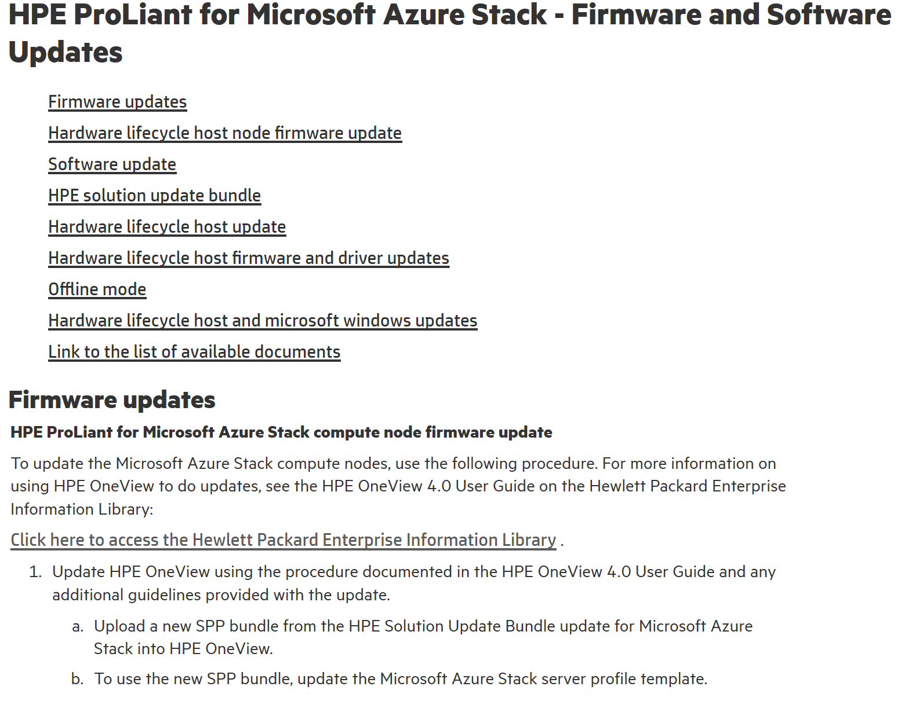
Release cadence
OEM Updates
Ask your OEM about their specific notification process to help make sure update notifications reach your organization, or check Microsoft’s release notes for more information about specific releases.
OEMs have their own release cycle for firmware, driver and other updates.
Example from HPE

Slide 14
Package versioning
Microsoft update packages have the following naming convention to easily identify the release date:
MajorProductVersion.YYMM.MinorVersion.BuildNumber
For example, the September 2018 release is 1.1809.0.90. The first Hotfix for 1809 would be 1.1809.1.x
See http://aka.ms/azurestackupdate for details.

Slide 15
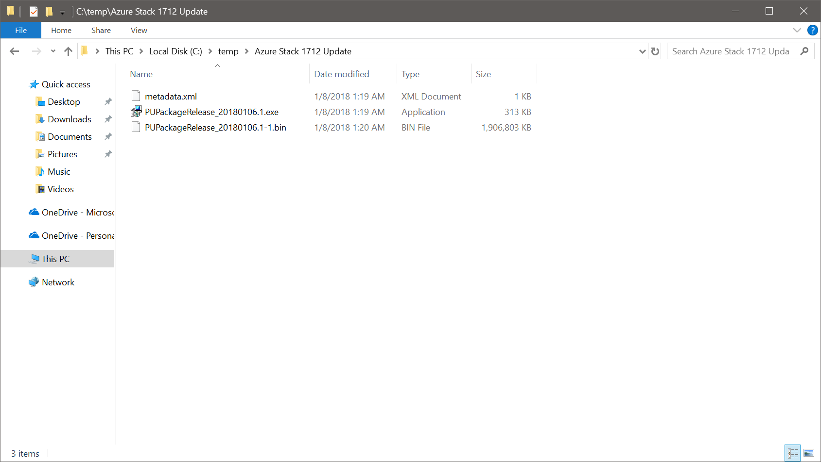
Package contents (1 of 2)
An update package typically consists of the following files:
A self-extracting PackageName.exe file. This file contains the payload for the update, for example the latest cumulative update for Windows Server.
Corresponding PackageName.bin files. These files provide compression for the payload that's associated with the PackageName.exe file.
A Metadata.xml file. This file contains essential information about the update, for example the publisher, name, prerequisite, size, and support path URL.

Slide 16
Package contents (2 of 2)
The metadata.xml contains relevant metadata for the update like Size, Name, MinVersion, Description etc:
</UpdatePackageManifest><UpdateName>AzS Update - 1.1809.0.90</UpdateName> <Version>1.1809.0.90</Version> <PackageSizeInMb>2379</PackageSizeInMb> <Description>AzS Update 1.1809.0.90</Description> <KBLink>https://aka.ms/azurestackupdate</KBLink> <MinVersionRequired> 1.1808.5.110 </MinVersionRequired>

Slide 17
AzS Updates
Read the Release Notes carefully!
Overview of Azure Stack Hub Updates
AzS Hotfix – 1.0.180312.1
Pre-Update
1712
1802
1803
AzS Update
KB4103348
AzS Hotfix –
1.0.180302.4
KB4103348
Post-Update
SQL RP 1.1.14.0
SQL RP 1.1.18.0
SQL Resource Provider

Slide 18


Updates: How do we do it?
Customers
Window Server monthly KB
Developer
Build
Continuous integration & Validation
…….
Hardware partner labs
Deploy & validate
Hardware partner labs
100’s of multi-node systems
Hardware partner labs
…….
…….
…….
4 node system
Long haul/Self-host environments
Testing by each partner
…….
10’s of multi-node systems

Slide 19
Update Flow

Slide 20
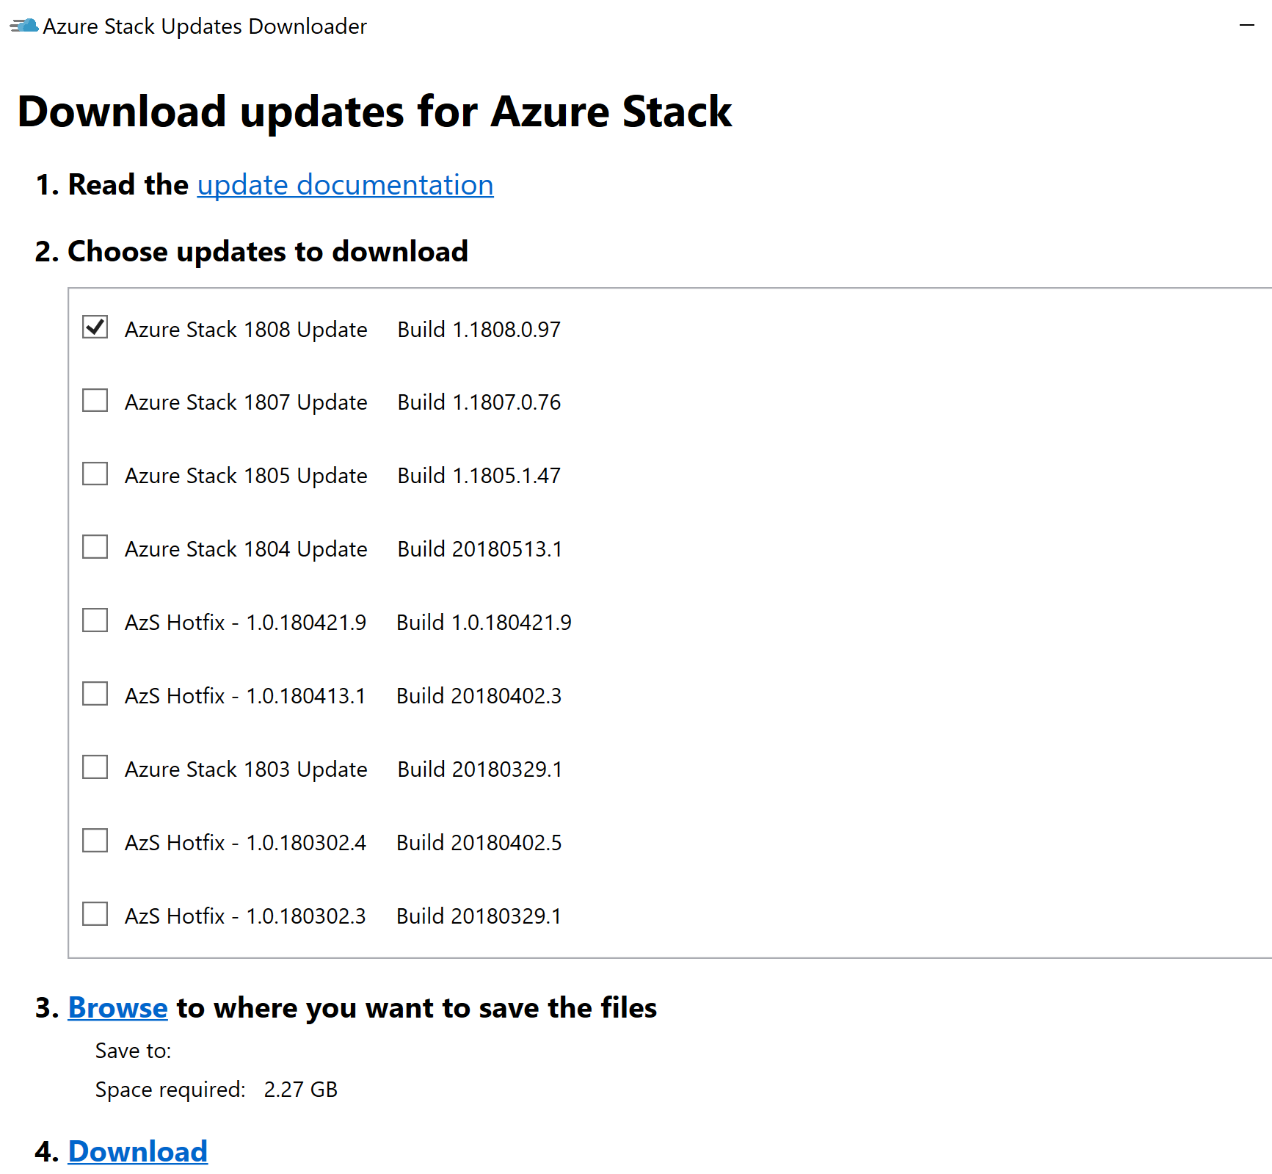
Azure Stack Hub Updates : Phase 1
Download & Run
Azure Stack Hub
Azure Stack Hub downloader
OS + Azure Stack Hub updates
Host OS
Image
New Host OS
Image + Azure Stack Hub SW
+
=
Stored on
\\infrastructure_share

Slide 21

Azure Stack Hub Updates – Phase 2
Min available capacity: Approximately one server
Each host server is evacuated and a fresh OS image is applied
Apply config
Boot from
Server 1
Server 2
Server 3
Server 4
VHD
(Host OS)
New VHD
(Host OS)
VHD
(Host OS)
New VHD
(Host OS)
VHD
(Host OS)
New VHD
(Host OS)
VHD
(Host OS)
New VHD
(Host OS)
4 – Server Azure Stack Hub

Slide 22
Azure Stack Hub Updates – Phase 3
Clustered fabric VMs have the cluster nodes replaced by fresh VMs one at a time
Min available capacity: Approximately one server
Apply image-based update to Azure Stack Hub Software
Boot from
Server 1
Server 2
Server 3
Server 4
New VHD
(Host OS)
New VHD
(Host OS)
New VHD
(Host OS)
New VHD
(Host OS)
4 – Server Azure Stack Hub

Slide 23
Example Times for applying updates
Times will vary depending upon workload
3 – 3.5 hours per Node
Goal: Limit workload impact during admin operations (patching, secret rotation)
Targeting availability offered by Azure

Slide 24
Administrative Tasks

Slide 25
Download update packages
Connected
Starting with Azure Stack Hub 1807 new updates and hotfixes automatically show up in the Administration Portal when they are available. There is no need to download them manually.
If necessary, it is still possible to download and upload them out of band.
Disconnected
In disconnected environments or environments with a weak internet connection, updates can be downloaded externally and uploaded to Azure Stack Hub.

Slide 26
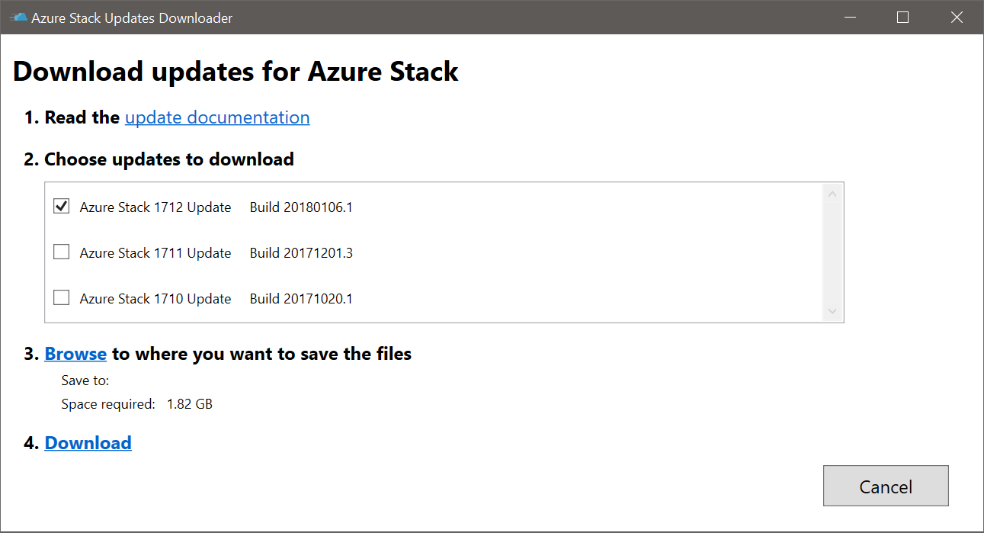
Download update packages
Disconnected / Out-of-band
For environments without Internet or with a bad Internet connection.
Azure Stack Hub Updates Downloader
aka.ms/azurestackupdatedownload
All update package related information is documented in the corresponding release notes:
Azure Stack Hub 1808 update https://docs.microsoft.com/en-us/azure/azure-stack/azure-stack-update-1808
Azure Stack Hub 1809 update https://docs.microsoft.com/en-us/azure/azure-stack/azure-stack-update-1809

Slide 27
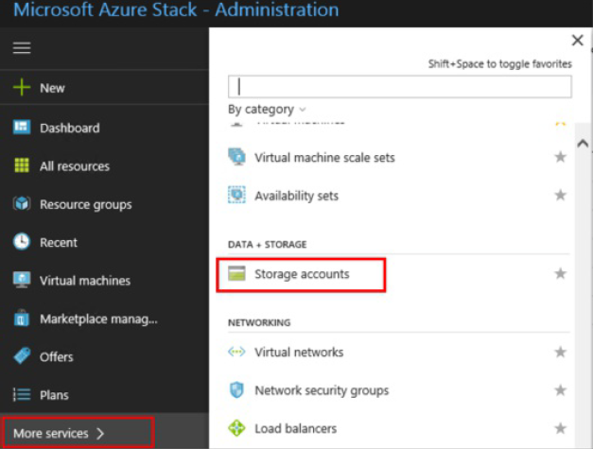
Upload update packages (1 of 6)
After downloading the Microsoft update package, you must upload the update package to your Azure Stack Hub Environment.
1. In the administrator portal, select More services. Then, under the Data + Storage category, select Storage accounts. (Or, in the filter box, start typing storage accounts, and select it.)

Slide 28
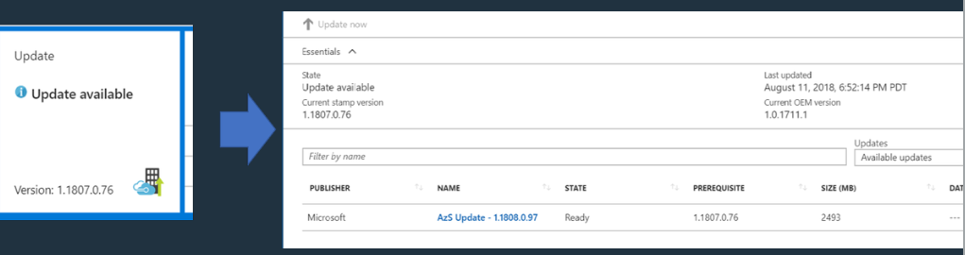
Updates are visible in the operator portal
Click on the update message to see details of the update

Slide 29
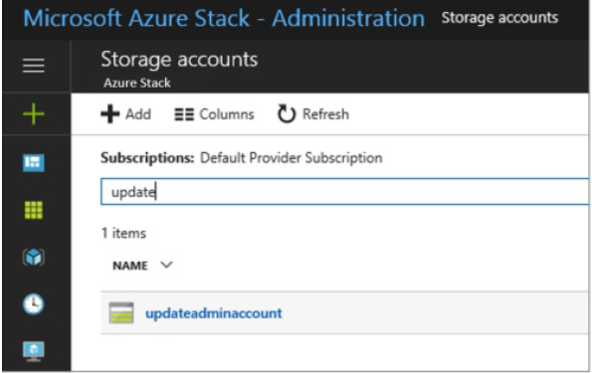
Upload update packages (2 of 6)
In the filter box, type update, and select the updateadminaccount storage account.

Slide 30
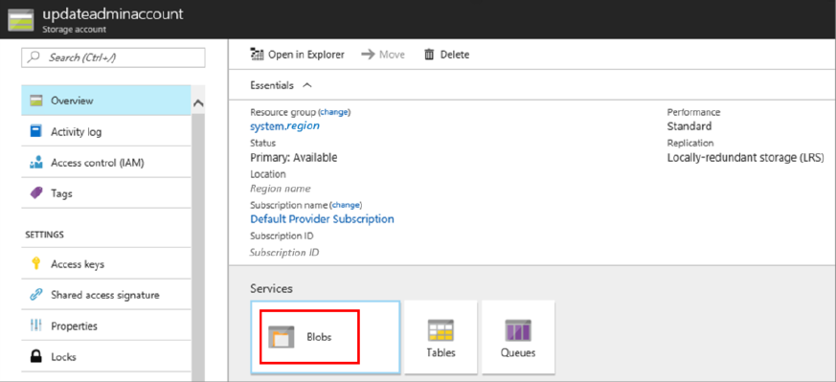
Upload update packages (3 of 6)
In the storage account details, under Services, select Blobs.

Slide 31
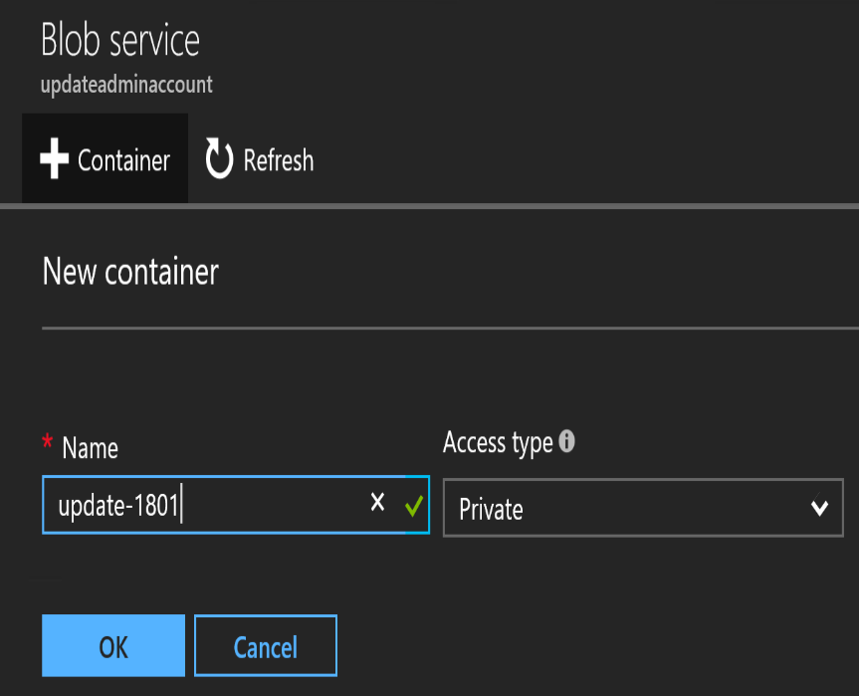
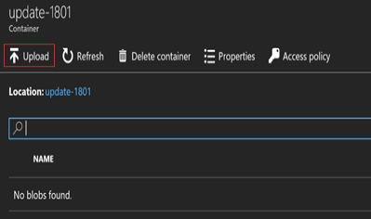
Upload update packages (4 of 6)
Under Blob service, select + Container to create a container. Enter a name (for example Update-1802), and then select OK.
After the container is created, click the container name, and then click Upload to upload the package files to the container.
Under Upload blob, click the folder icon, browse to the update package's .exe file, and then click Open in the file explorer window.

Slide 32
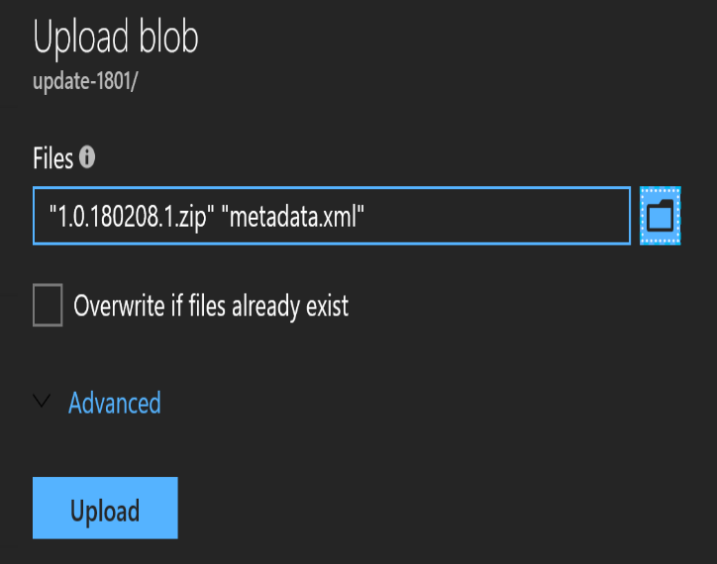
Upload update packages (5 of 6)
Under Upload blob, click Upload.
Repeat steps 6 and 7 for the PackageName.bin and Metadata.xml files. Or select multiple files at once.
When done, you can review the notifications (bell icon in the top-right corner of the portal). The notifications should indicate that the upload has completed.

Slide 33
Upload update packages (6 of 6)
Navigate back to the Update tile on the dashboard. The tile should indicate that an update is available. Click the tile to review the newly added update package.
To install the update, select the package that's marked as Ready and either right-click the package and select Update now, or click the Update now action near the top.
When you click the installing update package, you can view the status in the Update run details area. From here, you can also click Download full logs to download the log files.
When the update completes, the Update tile shows the updated Azure Stack Hub version.

Slide 34
Start updates
Requires AzureStack-Tools
Install-AzSUpdate applies a specific Azure Stack Hub Update that is downloaded and applicable.
Run Get-AzureStackUpdate to retrieve Update Version first
Install-AzsUpdate -Update "Update Version“
Get-AzsUpdate

Slide 35
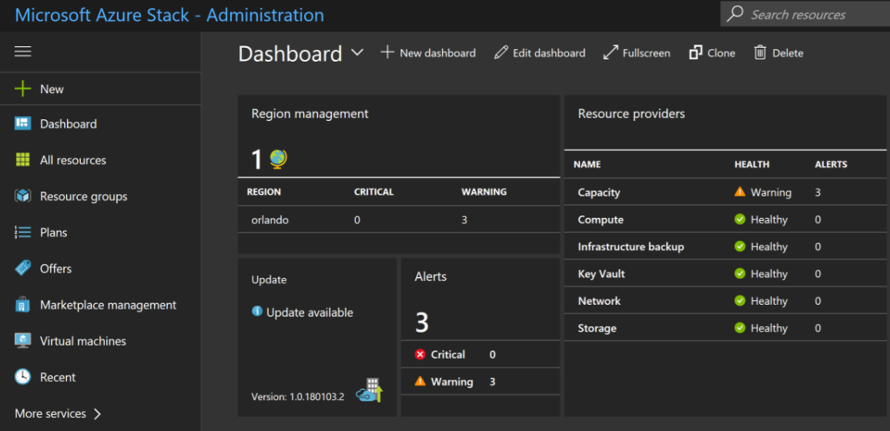
Start updates (using the Portal)
new update available

Slide 36
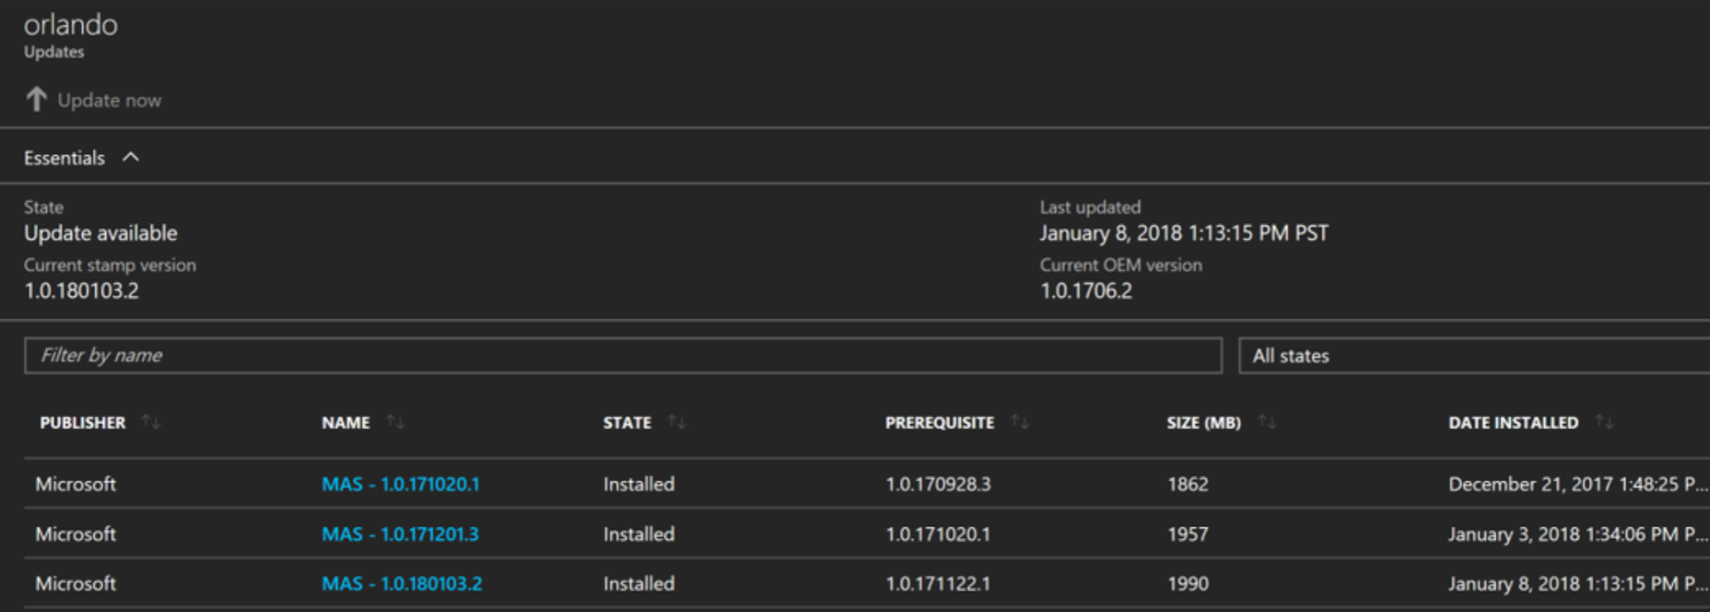
Start updates (using the Portal)
“Update now” to start
Installed and available updates

Slide 37
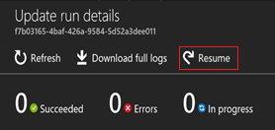
Resume updates
Failed Updates can be resumed through the Portal or the Privileged Endpoint (PEP).
If the update fails, you can resume the update run where it left off.
PowerShell Command
Resume-AzureStackUpdate Resumes a failed update at the point where it failed. In certain scenarios, you may have to complete mitigation steps before you resume the update.
$pepSession = New-PSSession -ComputerName Azs-ERCS01 ` -ConfigurationName PrivilegedEndpoint ` -Credential (Get-Credential)
Invoke-Command -Session $pepSession -ScriptBlock { Resume-AzureStackUpdate }

Slide 38
Monitor updates
You can use the privileged endpoint (PEP) to monitor the progress of an Azure Stack Hub update run, and to resume a failed update run from the last successful step should the Azure Stack Hub portal become unavailable.
Using the Azure Stack Hub portal is the recommended method to manage updates.
The Get-AzureStackUpdateStatus cmdlet returns the status of the currently running, completed, or failed update. It provides the high level status of the update operation and an XML document that describes both the current step and the corresponding state.
The Resume-AzureStackUpdate cmdlet resumes a failed update from the point where it failed. In certain scenarios, you may need to complete mitigation steps before resuming the update.

Slide 39
Azure Stack Hub tools (for update)
The Azure Stack Hub Infrastructure Administration module (part of the Azure Stack Hub Tools) give you some additional commands to manage Azure Stack Hub Updates through PowerShell.
Azure Stack Hub infrastructure administration https://github.com/Azure/AzureStack-Tools/tree/master/Infrastructure
Commandlet | Description
Get-AzsUpdateLocation | Review the Update Summary for a specified region.
Get-AzsUpdate | Retrieves list of Azure Stack Hub Updates
Install-AzsUpdate -Update "Update" | Applies a specific Azure Stack Hub Update that is downloaded and applicable. Run Get-AzureStackUpdate to retrieve Update Version first
Get-AzsUpdateRun -Update "Update" | Should be used to validate a specific Update Run or look at previous update runs

Slide 40
Azure Stack Hub Patch and Update Recap
Updates are (generally) released once a month
Support policy: N – 2 (E.g. 1808, 1807, 1805)
Updates include Security payload, new capabilities, bug fixes
Updates are non-cumulative
Hotfixes are issued as needed and are cumulative
Firmware updates are applied in a separate pass
Year
18
08
Month

Slide 41
Troubleshooting

Slide 42
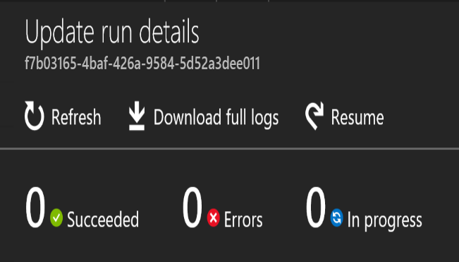
Analyze update logs (1 of 3)
Azure Stack Hub allows us to download the logfiles for all succeeded and failed updates per update run.
The logfile itself is a JSON File.

Slide 43
Analyze update logs (2 of 3)
Use PowerShell to display it in a better readable format:
$json = Get-Content C:\Updatelogs_4848628f-0f78-4b3f-9258-50728254a202.json | ConvertFrom-Json
# Get top-level steps
$json.properties.progress.steps.steps

Slide 44
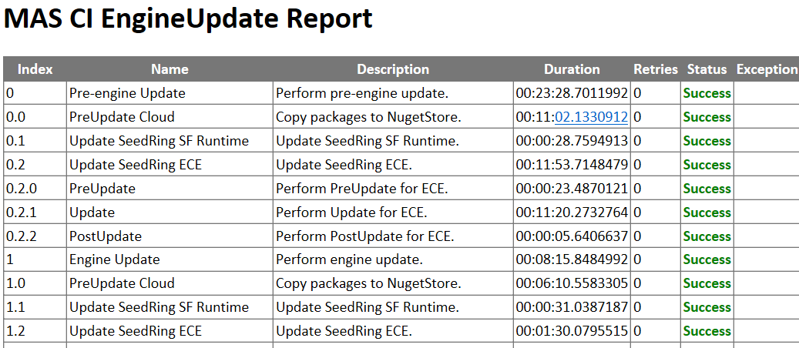
Analyze update logs (3 of 3)
Another option is to convert the JSON File into a HTML file for improved readability.

Slide 45
Get-AzureStackLog
To gather additional logs, you can use Get-AzureStackLog (for example from the Privileged Endpoint).
The example above will collect all Azure Stack Hub related Logfiles and write them onto a network share. The scope can be limited to URP (Update Resource Provider) logfiles only by using FilterByRole URP.
$pepSession = New-PSSession -ComputerName Azs-ERCS01 ` -ConfigurationName PrivilegedEndpoint ` -Credential (Get-Credential)
Invoke-Command -Session $pepSession -ScriptBlock {
Get-AzureStackLog -OutputDir \\accessible\path
}

Slide 46
Questions?

